Slide 1

SUICIDE
AWARENESS, PREVENTION, COUNSELLING and SOCIAL CHANGE
BY
Dr. PHILOMENA KANAGARAJ

Slide 2
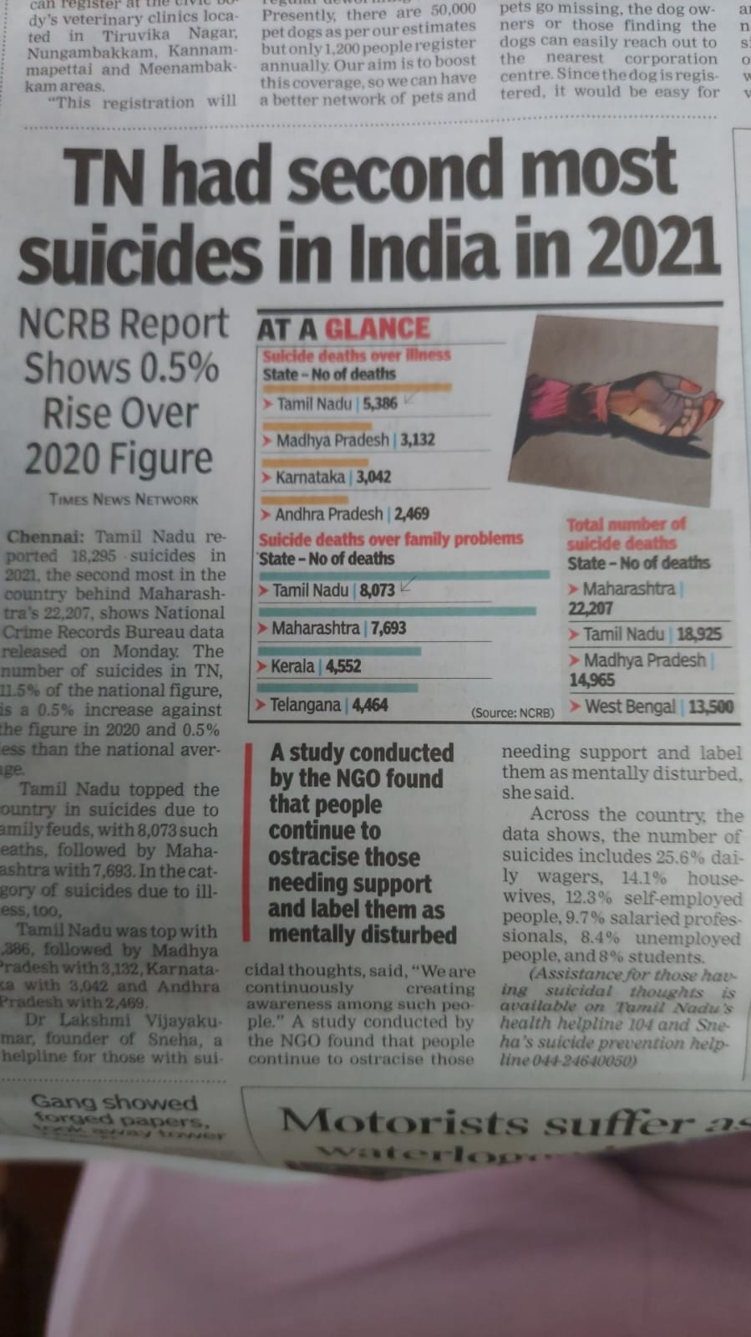

Slide 3

Tamil Nadu to appoint 800 doctors to counsel school students
Daily Hunt july 29th 2022
The sudden spike in student suicides have prompted Chief Minister MK Stalin to launch a dedicated programme among government school students about mental health and help them deal with problems better. Under the 'மாணவர் மனசு/Manavar Manasu' scheme, the DMK government in the state has decided to appoint 800 doctors to provide psychological counselling to school students. According to Minister for School Education Anbil Mahesh Poyyamozhi the project will be soon launched by Chief Minister. "As many as 800 doctors would be appointed, two each in 413 education blocks across the state, to provide counselling and guidance to students on various aspects such as studies, career and behavioural changes," the Minister said.

Slide 4
Defining, what is ‘Suicide’ ?
In Latin Suicidium, from Suicaedere ‘to kill oneself’ is the act of intentionally causing one’s own death.
Suicide is a desperate attempt to escape suffering that has become unbearable by taking one’s own life with whatever resources available.
Blinded by feelings of self-loathing, hopelessness, and isolation, a suicidal person can't see any way of finding relief except through death.
‘The act of taking one’s own life’.
But despite their desire for the pain to stop, most suicidal people are deeply conflicted about ending their own lives.

Slide 5
Some common misconceptions about Suicide
People who talk about suicide won’t really do it. (False)
Anyone who tries to kill himself/herself must be crazy. (False)
If a person is determined to kill himself/ herself, nothing is going to stop them. (False)
People who commit suicide are people who were unwilling to seek help. (False)

Slide 6
IV CAUSES of SUICIDE
Stress factors : financial difficulties, love failure, exam failure.
Often caused out of despair, frequently attributed to a mental disorder such as depression, bipolar disorder, schizophrenia, alcoholism or drug abuse, Substance abuse, smoking, gambling, medical conditions like cancer, traumatic brain injury, HIV, Insomnia, etc.
CAUSES In %age / numbers
Family Problems 84 suicides a day
Due Social & Economic causes. Married Men 71.6%
Due Emotional & Personal Married Woman 67.9%
Housewives 1 out of 6 suicides.

Slide 7
Methods (cont’d)
Dowry Deaths
Attempted suicides / non- fatal suicidal behaviour; Self-injury not resulting in death.
Assisted suicide – one person helps another
Euthanasia – where another person takes an active role in bringing about a person’s death.

Slide 8
SUICIDE PREVENTION
Warnings : by Dr. B.J. Prashantham
A/ NEVER IGNORE a suicide warning
B/ IMPORTANT to remove the capacity or thing to commit suicide. ‘ The Escape Hatch’, Reduce access to poisons, medications, firearms, kerosene etc. Also building barriers to bridges and subway platforms. (‘Suicide points’ at Hill stations – Kodaikanal, Ooty, Srinagar etc., )
C/ LISTEN, Listen and Listen to them.
D/ Usually Mode, Place & Time is planned
E/ DO Risk Assessment very early in the Counselling
F/ Don’t Hesitate to ask direct questions during the
counselling.

Slide 9
HOW TO IDENTIFY THE CLUES by Dr. BJ Prashantham
THE ‘RED FLAGS’
75% give clues to committing suicide.
1/ Clues : Verbal clues : Director or Indirect
2/ Behavioural – Dramatic mood swings or sudden personality changes, such as
(a) going from outgoing to withdrawn or
(b) well-behaved to rebellious
(c) lose interest in day-to-day activities,
(d) neglect his or her appearance, and
(e) show big changes in eating or sleeping habits.
3/ Resources - Contacts in legal, govt offices, spiritual circles.
Seeking access to medicines, poison, pesticides, knives, firearms, Kerosene or other objects that could be used in a suicide attempt.

Slide 10
How to identify the clues (Cont’d----)
4/ Situational - Depending on the situation -
5/ Descriptive - Very young
6/ Symptomatic
Unhealthy Healthy
i Deny Own & Accept
ii/ Not do anything Will Do something about it
iii/ Does not seek help when Seeks help beyond problem gets worse himself.
iv/ Problem gets worse, When help is given does not accept help accepts it.
v/ No change Leads to change.

Slide 11
TEENS : HOW TO IDENTIFY THE SUICIDAL WARNING CLUES in Teens (Cont’d…)
Change in eating and sleeping habits
Withdrawal from friends, family, and regular activities
Violent or rebellious behaviour, running away
Drug and alcohol use
Unusual neglect of personal appearance
Persistent boredom, difficulty concentrating, or a decline in the quality of schoolwork
Frequent complaints about physical symptoms, often related to emotions, such as stomach aches, headaches, fatigue, etc.
Not tolerating praise or rewards

Slide 12
XI COUNSELLING THE SUICIDAL
Case Study : a) Sudha’s and b) King’s.
1/ Educational Counselling
In today’s world of growing technology, and competing to get the best out of life, education, career, promotions etc. by whatever means, the child goes through Stress in keeping up catching up with his/her parents’ expectations in studies.
Study of suicidal cases, have shown that :
a/ Parental Maturity is lacking
b/ Expectations are high from parents – Westism
c/ Comparing with other children, youth.
d/ How to fail or lose gracefully.

Slide 13
1/ Educational Counselling The ‘HOW’
Organise Seminars, Lectures, Workshops about Suicide Awareness, Suicide Prevention, Counselling and Social Change, How to fail/lose gracefully; etc.,
a/ through Lions, Alumni Assn Clubs etc.
b/ through Schools, Colleges, Orphanages
c/ in Churches, Youth Meetings, Children’s Bible School etc.,
d/ Rallys, Walks, etc. Spreading awareness.
e/ Distributing Leaflets / Pamphlets
f/ Through Emails/Facebook/ etc.

Slide 14
XI 2) SUPPORTIVE COUNSELLING
1/ Family
2/ Teachers, Lecturers, Professors, Pastors, Youth Pastors etc.
3/ Peer Group Support and Counselling
Those at the highest risk for committing suicide in the near future have a specific PLAN, the MEANS to carry out, a TIME SET for doing it, and an INTENTION TO DO IT.

Slide 15
XI 3) RE-CONSTRUCTIVE COUNSELLING
a/ Client Centered Counselling
b/ REBT : The Rational Emotive Behaviour Therapy
c/ MBTI : Myers &: Briggs Type Indicator
d/Forgiveness (Relaxation & Imagery) therapy
e/ The Gestalt method

Slide 16
WHAT CAN I DO ?
(Brainstorming)
World Suicide Prevention Day, 10th
September
Spread Awareness
Be Empathetic
LISTEN, listen and listen

Slide 17
SOCIAL CHANGE
1/ Rehabilitation of those who survive suicidal attempt
2/ Suicide is a medico-legal case
3/ De-criminalize suicide
4/ World Suicide Prevention Day,
10th September,

Slide 18
SOCIAL CHANGE (cont’d…)
5/ WHAT CAN I DO TO SAVE A LIFE ?
Never ignore anyone who speaks about suicide.
LISTEN, LISTEN and LISTEN to them.
Remove the source (poison, pesticides, firearm, knife, kerosene etc.) from their possession.
Do not hesitate to ask direct questions.
Do not, under any circumstances, leave a suicidal person alone.
Seek Professional Help, a Medical Doctor, Psychological Counsellor, Psycho therapist.

Slide 19
CONCLUSION : Action Plan
Lighting a candle near a window at 8 PM in support of : World Suicide Prevention Day, Suicide Prevention and Awareness, Survivors of Suicide and for the memory of Loved Lost Ones.
Distribute Leaflets, Pamphlets, Posters or written information to bring about awareness, about suicide prevention and counselling the suicidal on 10th September, – World Suicide Prevention Day.
Teenagers in neighbourhood
Youth in Slum, Chetput, Chennai
Later, continue in our Circles of Influence, as discussed above.

Slide 20
THANK YOU
THANK YOU for your patient listening.
Any questions please ?
By Dr. Philomena Kanagaraj

Slide 21
BIBLIOGRAPHY
1/ Prashantham, Dr., B.J., Indian Case Studies in Therapeutic Counselling, published by Christian Counselling Centre, Vellore, Tamil Nadu, India, 6^{the} Edition 2005
2/ Lecture Notes by Dr. BJ Prashantham at CCC, Vellore July/August 2013

